Slide 1

Unit 1: Basic Economic Concepts

Slide 2


WE HAVE A PROBLEM!!
The Economizing Problem…
Scarcity
Society has unlimited wants but unlimited resources

Slide 3
The Production Possibilities Curve (PPC)
Using Economic Models…
Step 1: Explain concept in words
Step 2: Use numbers as examples
Step 3: Generate graphs from numbers
Step 4: Make generalizations using graph

Slide 4
What is the Production Possibilities Curve?
A production possibilities graph (PPG) is a model that shows alternative ways that an economy can use its scarce resources
This model graphically demonstrates scarcity, trade-offs, opportunity costs, and efficiency.
4 Key Assumptions
Only two goods can be produced
Full employment of resources
Fixed Resources (Ceteris Paribus)
Fixed Technology

Slide 5
Production “Possibilities” Table
a
b
c
d
e
f
Pizzas
14
12
9
5
0
0
Giant Robots
0
2
4
6
8
10
Each point represents a specific combination of goods that can be produced given full employment of resources.
NOW GRAPH IT: Put Pizzas on y-axis and Giant Robots on x-axis

Slide 6
Production Possibilities
How does the PPG graphically demonstrates scarcity, trade-offs, opportunity costs, and efficiency?
14
12
10
8
6
4
2
0
Impossible/Unattainable
(given current resources)
A
B
G
C
Pizzas
Efficient
D
Inefficient/ Unemployment
E
0 2 4 6 8 10
Giant Robots

Slide 7

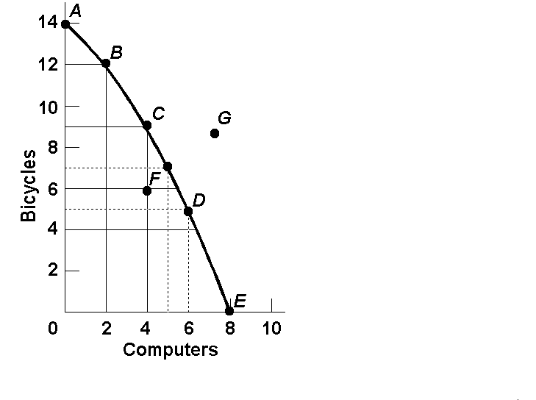
Opportunity Cost
Example:
  1. The opportunity cost of moving from a to b is…
2 Bikes
  2.The opportunity cost of moving from b to d is…
7 Bikes
  3.The opportunity cost of moving from d to b is…
4 Computer
  4.The opportunity cost of moving from f to c is…
0 Computers
  5.What can you say about point G?
Unattainable

Slide 8
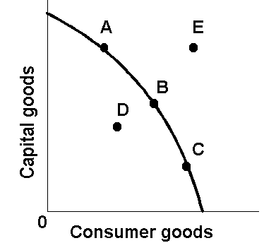
The Production Possibilities Curve (or Frontier)

Slide 9

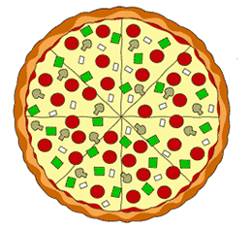
Production Possibilities
A B C D E
CALZONES 4 3 2 1 0
PIZZA 0 1 2 3 4
List the Opportunity Cost of moving from a-b, b-c, c-d, and d-e.
Constant Opportunity Cost- Resources are easily adaptable for producing either good.
Result is a straight line PPC (not common)

Slide 10

Production Possibilities
A B C D E
PIZZA 20 19 16 10 0
ROBOTS 0 1 2 3 4
List the Opportunity Cost of moving from a-b, b-c, c-d, and d-e.
Law of Increasing Opportunity Cost-
  As you produce more of any good, the opportunity cost (forgone production of another good) will increase.
  Why? Resources are NOT easily adaptable to producing both goods.
Result is a bowed out (Concave) PPC

Slide 11
Constant vs. Increasing Opportunity Cost
Identify which product would have a straight line PPC and which would be bowed out?
Corn
Cactus
Wheat
Pineapples

Slide 12
PER UNIT Opportunity Cost
  How much each marginal unit costs
  = Opportunity Cost
  Units Gained
Example:
  1. The PER UNIT opportunity cost of moving from a to b is…
1 Bike
  2.The PER UNIT opportunity cost of moving from b to c is…
1.5 (3/2) Bikes
  3.The PER UNIT opportunity cost of moving from c to d is…
2 Bikes
  4.The PER UNIT opportunity cost of moving from d to e is…
2.5 (5/2) Bikes
NOTICE: Increasing Opportunity Costs

Slide 13
The Production Possibilities Curve and Efficiency

Slide 14
Two Types of Efficiency
Productive Efficiency-
  Products are being produced in the least costly way.
  This is any point ON the Production Possibilities Curve
Allocative Efficiency-
  The products being produced are the ones most desired by society.
  This optimal point on the PPC depends on the desires of society.

Slide 15
Productive and Allocative Efficiency
Which points are productively efficient?
Which are allocatively efficient?
14
12
10
8
6
4
2
0
Productively Efficient combinations are A through D
A
B
G
Allocative Efficient combinations depend on the wants of society
(What if this represents a country with no electricity?)
Bikes
C
E
F
D
0 2 4 6 8 10
Computers

Slide 16
Why two types of efficiency?
Is combination “A” efficient?
Yes and No. It is productively efficient but it is not the combination society wants
Size 20 running shoes
A
Size 10 running shoes

Slide 17
Shifting the Production Possibilities Curve

Slide 18
Production Possibilities
4 Key Assumptions Revisited
Only two goods can be produced
Full employment of resources
Fixed Resources (4 Factors)
Fixed Technology
What if there is a change?
3 Shifters of the PPC
  1. Change in resource quantity or quality
  2. Change in Technology
  3. Change in Trade

Slide 19
Production Possibilities
What happens if there is an increase in population?
Robots
Pizzas

Slide 20
Production Possibilities
What happens if there is an increase in population?
Robots
Pizzas

Slide 21
Production Possibilities
What if there is a technology improvement in pizza ovens
Robots
Pizzas

Slide 22
Production Possibilities
What if there is a technology improvement in pizza ovens
Robots
Pizzas

Slide 23
Capital Goods and Future Growth
Countries that produce more capital goods will have more growth in the future.
Panama – Favors Consumer Goods
Mexico – Favors Capital Goods
Current
PPC
Future
PPC
Future
PPC
Capital Goods
Current
PPC
Capital Goods
Consumer goods
Consumer goods
Panama
Mexico

Slide 24
PPC Practice
Draw a PPC showing changes for each of the following:
Pizza and Robots (3)
1. New robot making technology
2. Decrease in the demand for pizza
3. Mad cow disease kills 85% of cows
Consumer goods and Capital Goods (4)
4. Destruction of power plants leads to severe electricity shortage
5. Faster computer hardware
6. Many workers unemployed
7. Significant increases in education

Slide 25
Question #1
New robot making technology
Q
A shift only for Robots
Robots
Q
Pizzas

Slide 26
Question #2
Decrease in the demand for pizza
Q
The curve doesn’t shift!
A change in demand doesn’t shift the curve
Robots
Q
Pizzas

Slide 27
Question #3
Mad cow disease kills 85% of cows
Q
A shift inward only for Pizza
Robots
Q
Pizzas

Slide 28
Question #4
Oil Spill in the Gulf
Q
Decrease in resources decrease production possibilities for both
Capital Goods (Guns)
Q
Consumer Goods (Butter)

Slide 29
Question #5
Faster computer hardware
Q
Quality of a resource improves shifting the curve outward
Capital Goods (Guns)
Q
Consumer Goods (Butter)

Slide 30
Question #6
Many workers unemployed
Q
The curve doesn’t shift!
Unemployment is just a point inside the curve
Capital Goods (Guns)
Q
Consumer Goods (Butter)

Slide 31
Question #7
Significant increases in education
Q
The quality of labor is improved. Curve shifts outward.
Capital Goods (Guns)
Q
Consumer Goods (Butter)

